Slide 2
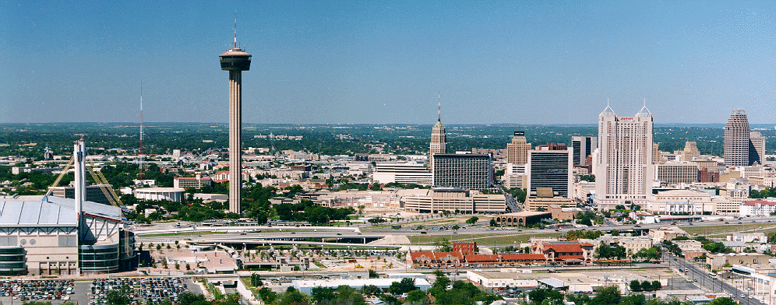
San Antonio’s Water Challenge
Water and Wastewater services to over 1.6 million people and growing
Regulations are getting stricter
New water supplies are expensive and challenging to acquire
Notes:
SAWS and the entire State of TX are facing challenges of developing new water supplies for a growing population, while drought restrictions and regulations are getting stricter.
SAWS already banks on anywhere from 20%- 40% of our water supplies lost during a drought year. And therefore must develop adequate supplies to meet the needs
Just as with all cities across Texas, developing new water supplies is very expensive, and very challenging, particularly from a regulatory standpoint.
CLICK

Slide 3
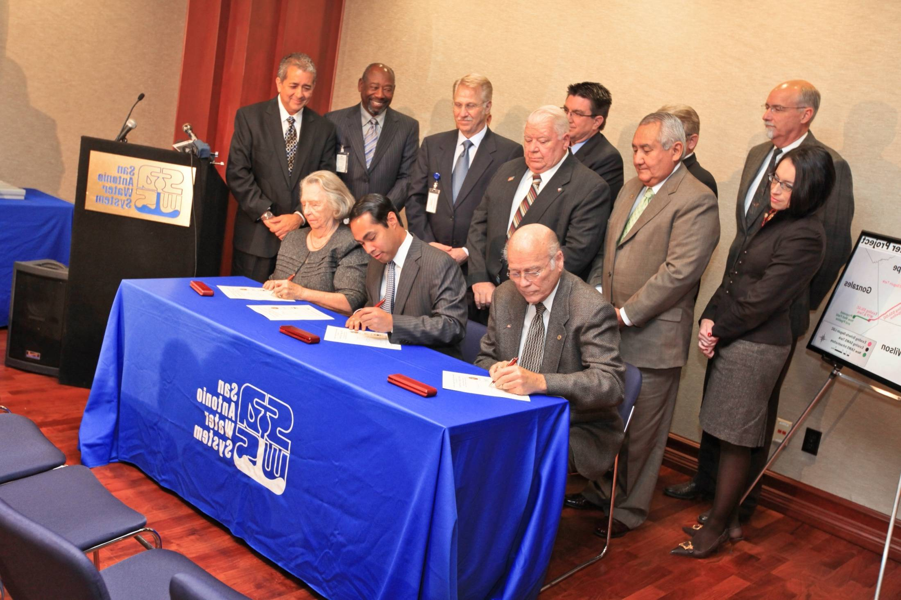
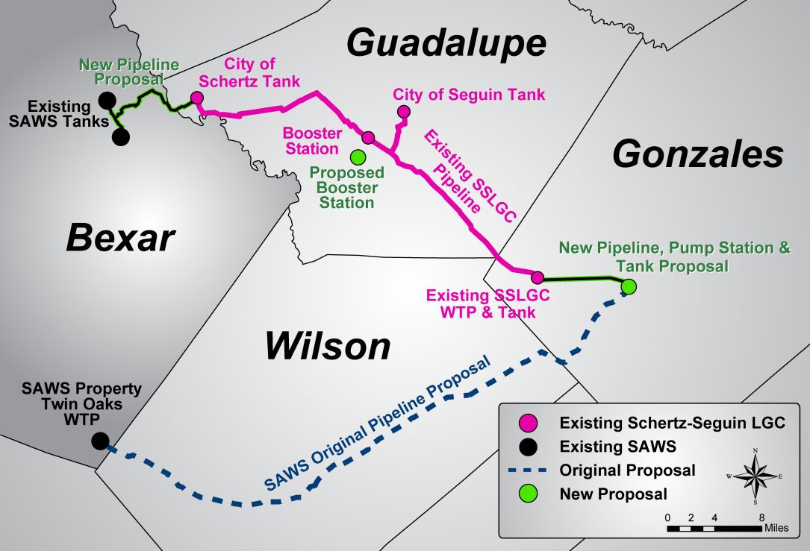
Successful Water Management
Increased supplies by 39% since 2004, through several historic droughts
  Including ASR, increased by 79%
Regional Water Partnership with Schertz-Seguin
  Saving ratepayers over ~$88 million
Aquifer Storage & Recovery
Model of Water Conservation
Notes:
We are great!
…
…
And we are already THE model for successful Conservation

Slide 4
Managing Water Demand
Per Capita Water Use
225
40% Reduction in the last 30 years
Gallons per Person per Day (GPCD)
127

Slide 5
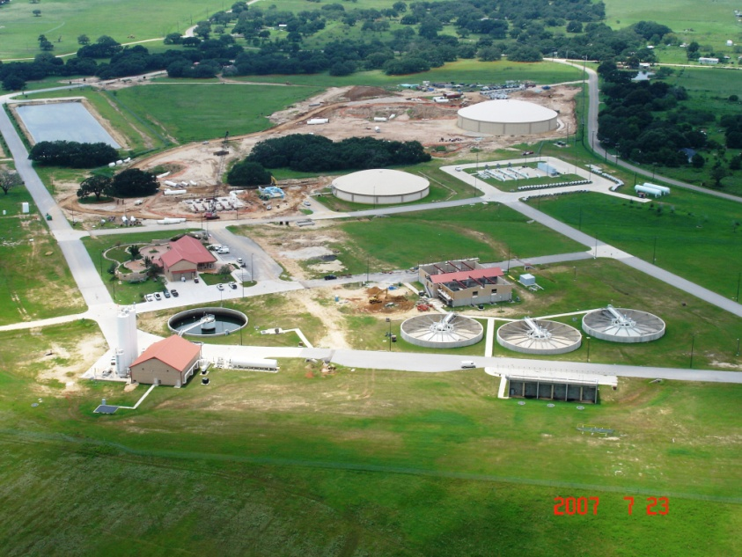
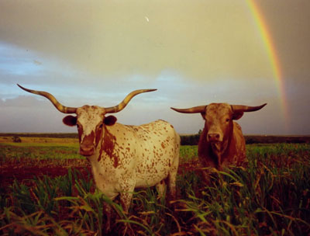
Aquifer Storage & Recovery (ASR)
No Loss to Evaporation
3,200 acres in South Bexar County
  One of largest in the nation
  1/3rd of annual demand stored
  3 water projects on same site
Property leased back to landowners for ranching
Cornerstone of regional water supply solution (EARIP)

Slide 6
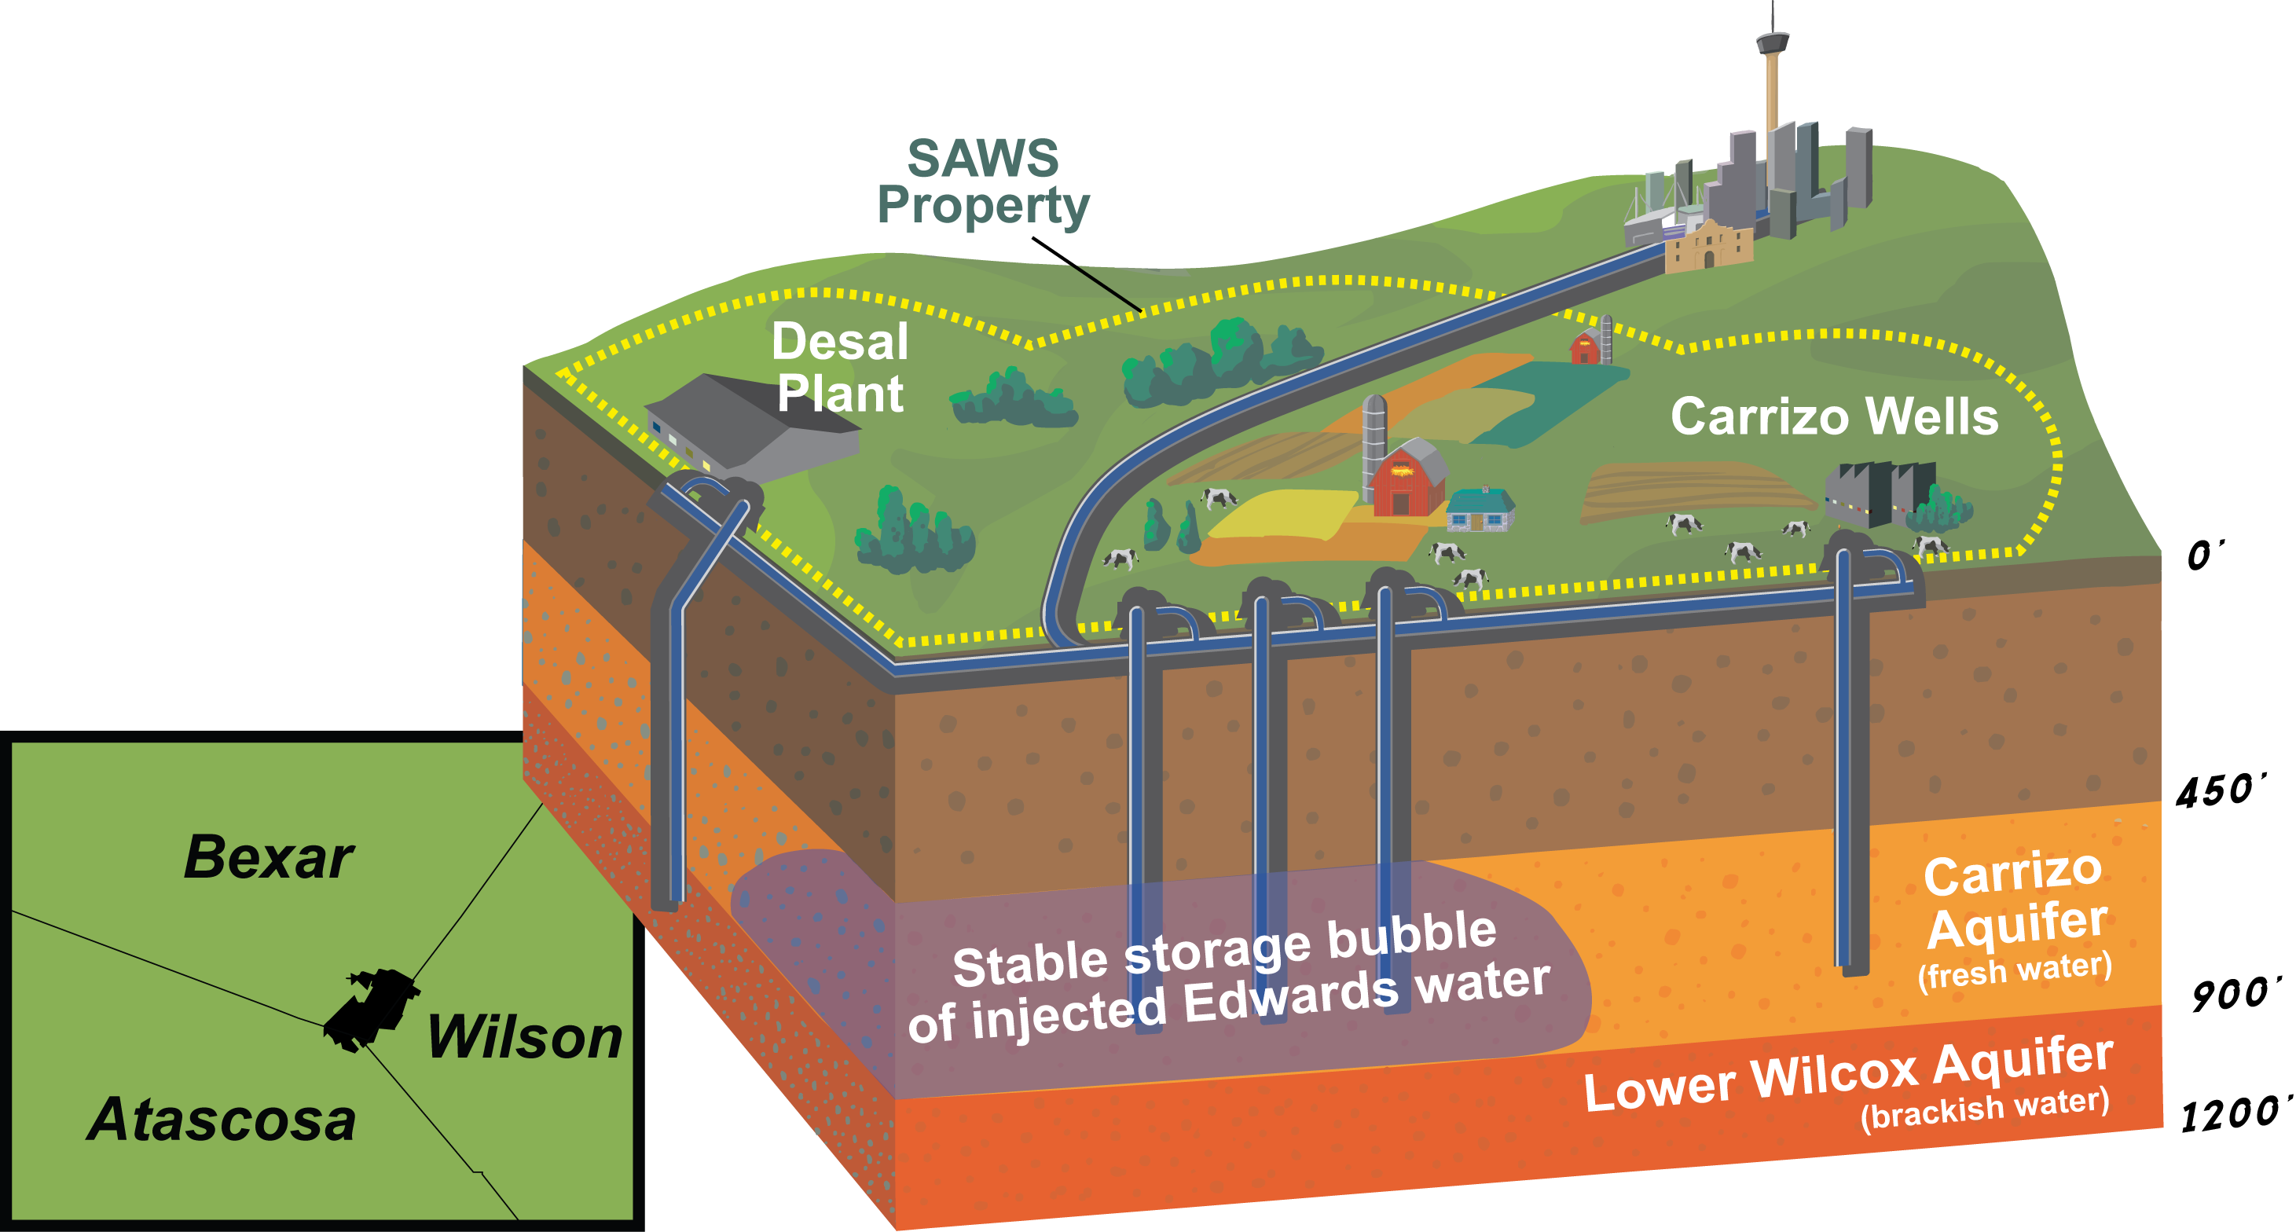
Aquifer Storage & Recovery (ASR)
Saving for a Dry Day
Notes:
During wet years, we pump our permitted water from the Edwards Aquifer and pipe it to southern Bexar County, where we inject the water into the Carrizo Aquifer.
In dry years when our pumping is restricted from the Edwards, we have drawn from these stored supplies of water and pumped it back to San Antonio.
We currently have 93,000 acre-feet of water stored in the ASR, or roughly one half of our annual potable demand
Without contamination, evaporation concerns of surface water reservoirs.
Also, now ASR is also cornerstone of historic EARIP process in Edwards region – in HCP, ASR is utilized to offset Edwards pumping demands to increase spring flows and protect Endangered Species in drought of record conditions.

Slide 7
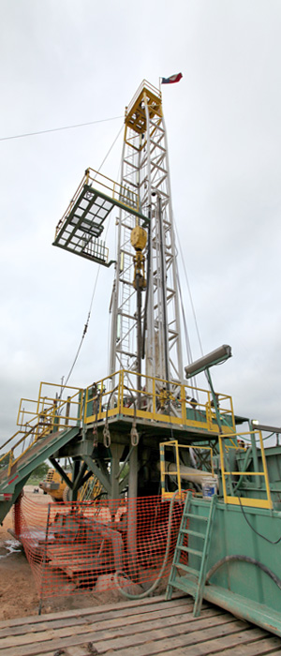
Brackish Groundwater Desalination
Background
2.7 billion acre feet in Texas, over 400 million acre-feet in Region L alone
The Lower Wilcox Aquifer is “one of the best potential sources for brackish water in Texas” (TWDB)
Un-tapped, abundant and reduces freshwater demand
Notes:
I am here today to focus on development of Brackish groundwater, and many of you know that we have a plant beginning construction.
We pursued this project, in part, because we recognized that there were oceans of groundwater beneath our feet that no one was using, and no one planned on using this water.
The TWDB had also recognized and focused on South Central Texas, particularly the Carrizo-Wilcox Aquifer, as being one of the best sources of brackish water in Texas
We had also experienced political opposition to various fresh water, and surface water projects that had been planned. So we pursued a 28,000 ac-ft brackish project to be built in Bexar County with production from Atascosa, Wilson and Bexar County
However, we faced political opposition again from a small handful of local citizens who impacted the local groundwater district Board members.
We worked with the citizens, local officials and groundwater district for many months. We created a science Committee roundtable. The Groundwater District even hired their own science expert who ended up agreeing with SAWS.
However, the Groundwater District Board was still not satisfied and ultimately passed brackish rules that were adverse to our project, and this led SAWS to decide to move the project entirely into Bexar County until some future date. So, as you will see, most of our lessons learned revolve around how that political environment has shaped our project and changes we suggest to the local regulatory landscape.

Slide 8

Brackish Desalination Press
“
“
[Desalination] may prove to be the most important component of any solution to America’s water shortages.
Susan Combs, Comptroller
January 2014
“
“
HB 4 helps ensure Texas has a reliable water supply for the next 50 years… while further developing brackish and desalination water treatment.
Governor Rick Perry
May 2013
Notes:
Instead, in San Antonio, we saw these headlines about our successful water management

Slide 9
Brackish Desalination Press
“
“
Desal is the answer all over the world.
State Representative Lyle Larson
February 2014
“
“
Senator [Fraser] touts fix for water, power issues
He wants power plants built where brackish water can be desalinated.
Austin American Statesman
January 2014
Notes:
Instead, in San Antonio, we saw these headlines about our successful water management

Slide 10
Three Phase Brackish Project
First Phase Online 2016
33,600 ac-ft/yr by 2026
15% of SAWS current water supply
$109 million in Texas Water Development Board (TWDB) low interest loans
Notes:
The project now is to be developed within Bexar County, and we plan to expand into Wilson and Atascosa Counties at some point in the future
The first phase of the project is coming on line in 2016 at just over 11,000 ac-ft
The current project design is to be complete in 2026, delivering over 30,000 ac-ft at a cost of almost $300 Million
At that time, the project would provide approximately 15% of SAWS current water supply
The State has invested in the project through low interest loans from the TWDB
The project ultimately has the ability to expand as big as needed given that the TWDB has noted over 400 Million ac-ft of brackish water available throughout the Region L area.

Slide 11

Potential Partnership with CPS Energy
Co-location of electricity generation with SAWS Brackish project
Utility synergy and sustainability
Model Partnership throughout Texas & Nation

Slide 12
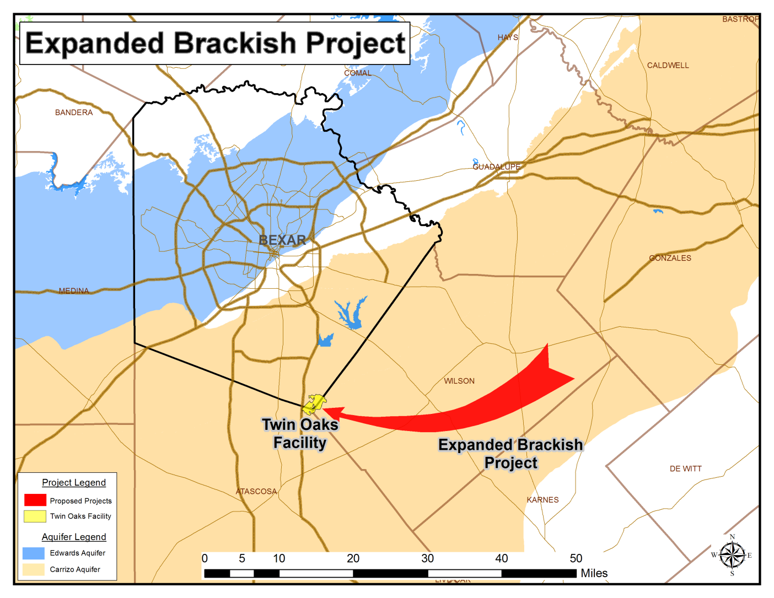
Expansion of Brackish Desalination
Project Location for Additional 50,000 ac-ft

Slide 13
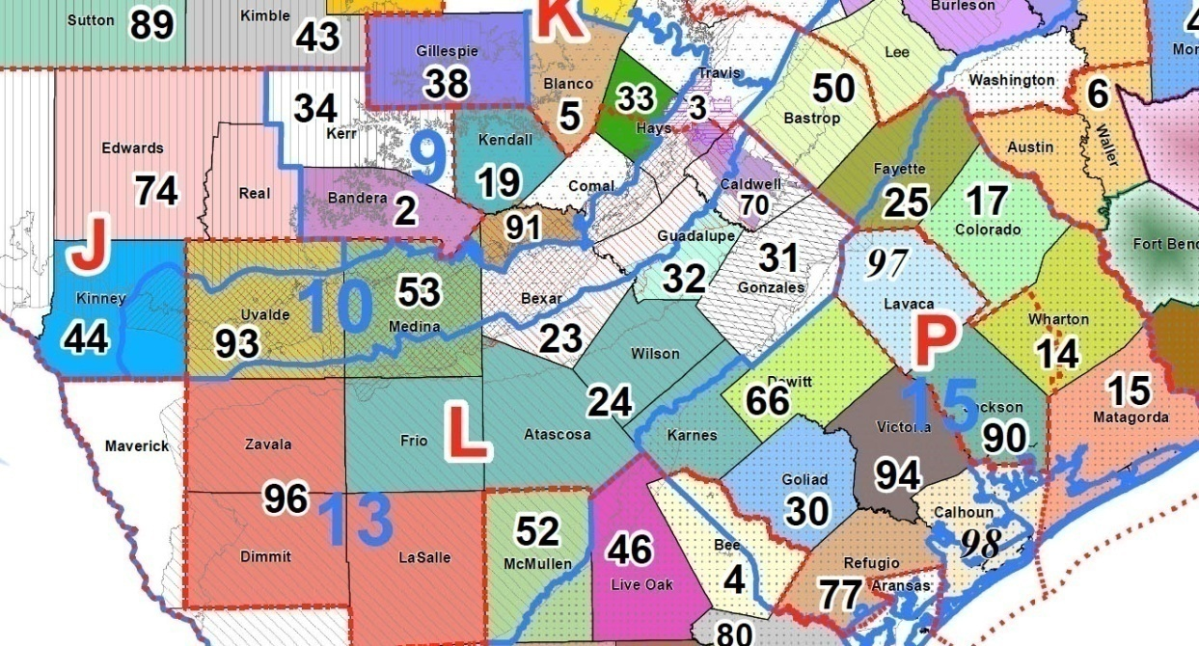





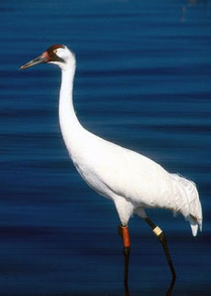
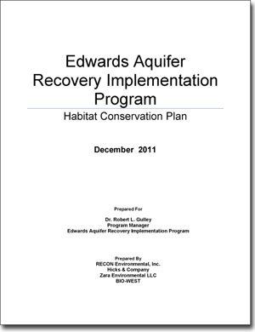
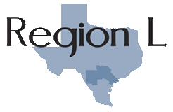
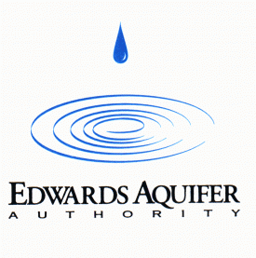

Legal and Regulatory Challenges
Groundwater Conservation Districts
Notes:
When we talk about SAWS’ brackish project, science and cost are not biggest the obstacle in developing this project. Local regulations are our biggest obstacle to developing brackish groundwater
This slide just shows a sampling of the multitude of various regulatory processes we get to go through in developing new water supplies.
San Antonio is no stranger to adapting our water resources to regulatory challenges. You will recall that our primary water supply – Edwards Aquifer – was curtailed in the 1990s through a federal endangered species lawsuit.
That action has caused SAWS to seek water resources outside of our political boundaries.
However, as we go outside of Bexar County, the regulatory environment continues to evolve, and sometimes specifically in reaction to a project that we would like to develop.
A changing regulatory environment has usually been adverse to developing water projects outside of our area.
We believe development of brackish groundwater should be a win-win solution that can bring new water supplies to a growing community, while also leaving access to shallower fresh water supplies to local smaller communities.

Slide 14
Legislative Changes Needed
Promotion of Alternative Water Supplies
Separate regulatory structure for brackish groundwater and ASR Development
  Long Term permits for large projects
  Favorable Desired Future Conditions and Groundwater District Rules
    Ensure District Rules based on Science, not politics
  Meaningful appeals process for local groundwater district decisions
Notes:
As I said above, we scaled back and reconfigured the project to Bexar County after our experiences in Wilson and Atascosa. However, for further expansion of brackish there is need for reasonable regulatory reform that we believe can be done in partnership with groundwater districts.
The key to development for water utilities is a stable and equitable regulatory environment.
That calls for long term permit certainty, an adequate voice in development and appeals of Desired Future Conditions, Regulatory Incentives for development of Brackish groundwater and investments in ASR.

Slide 15
Conclusions
Securing our Water Future
8.3 million acre-feet of additional water needed for Texas
Oceans of brackish groundwater available, yet underutilized
Costs and Regulations are barriers
Long Term certainty in groundwater regulations is needed
Alternative supplies are win-win
Notes:
In conclusion, Texas will need to meet the needs of a growing population – particularly in geographic triangle between Houston, Dallas and San Antonio
Need to develop 8.3 million acre ft by 2060
As I’ve discussed, we’ve been innovative and efficient in managing our resources and are International models of water conservation, but growth necessitates new supply
Much of the future growth focus will be on brackish groundwater.
Regulatory and permitting certainty for brackish development is necessary.
Particularly important as we consider funding the State Water Plan and putting state dollars behind these projects.
We think that brackish groundwater development can be a win-win for all parties involved, and will hold great promise for future water supplies.
However, it needs to be done right, and we want to continue working with GCDs to find solutions going forward.

